Slide 1
SASK LONG COVID PARTICIPANT PORTAL
CMPT 371 - Team 2

Slide 2

Our Team

Slide 3
Roles
Project Manager | Build Manager | Risk Manager | Dev Lead | Devs | Test Lead | Testers
Jeet | Riley | Hari | Ini | Chi, Dillon, Alex | Sashti | Vaidehi, Herv

Slide 4


Project Description
SASK Long COVID Participant Portal is a web application where administrators of the study can upload data collected via the Ethica app and participants can view their individual data and reflect on their health journey.
Notes:
Hello.

Slide 5
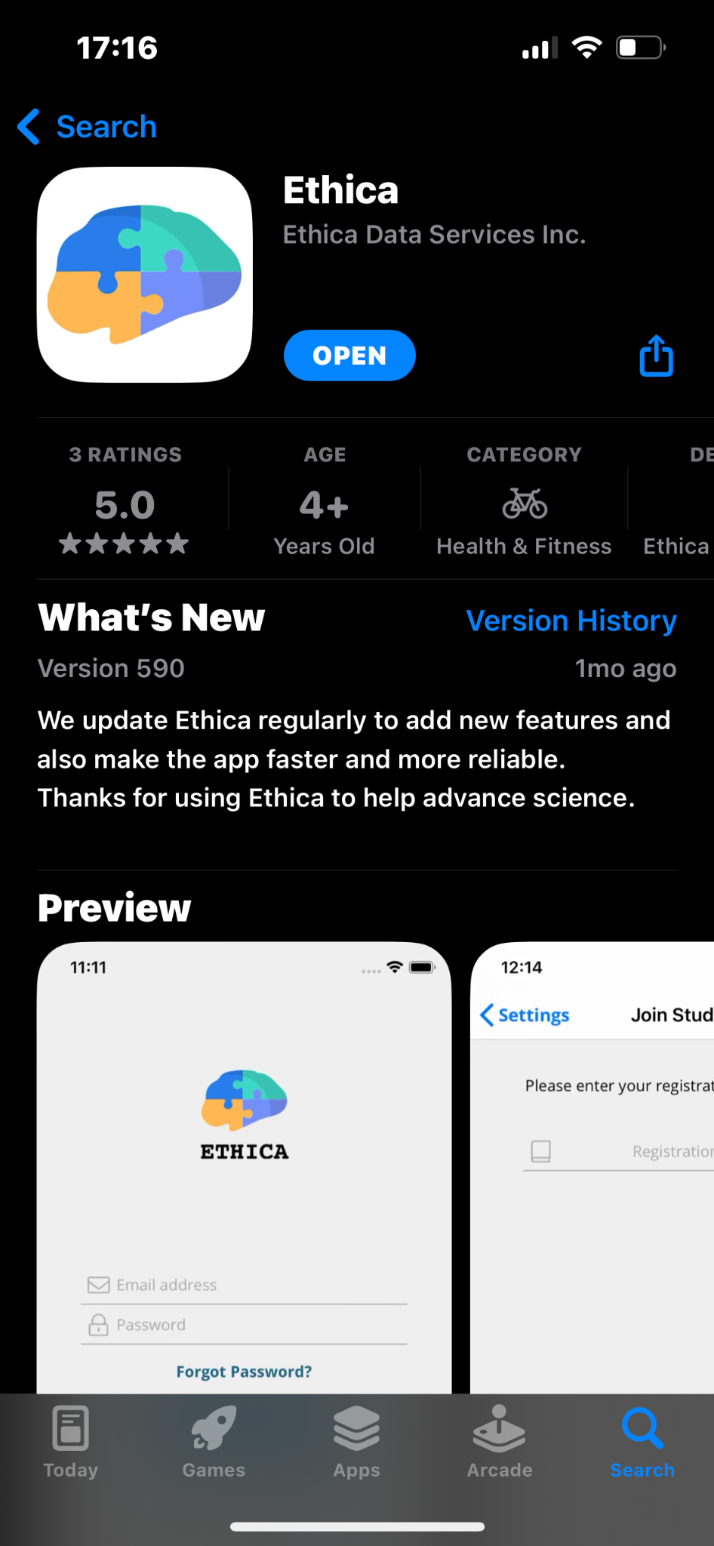
How does it work?
Participants of the Sask Long Covid study inputs their data in the Ethica App periodically.
The administrators then upload the data in csv file format to our web app.
The users can then view it on the portal’s side interface in forms of graphs and tables.

Slide 6

Tech Stack
Frontend
React (Typescript)
https://reactjs.org/
Backend
Node.js - Express (Typescript)
https://nodejs.org/en/about/
Database
PostgresSQL
https://www.postgresql.org/about/
Notes:
For our tech stack, we are using PostgreSQl for the database, node and express for the backend and react for the frontend . When deciding on a database for our project, we ultimately chose PostgreSQL. One reason was that we required a relational database to effectively manage the different types and interactions of data that would be presented to our users through various views. Additionally, using PostgreSQL in conjunction with a Node based application greatly simplifies deployment process and the database being sql allows for continuity in the project beyond this class as a lot of developers are familiar with sql. We would also be using typescript rather than JavaScript for node, express and react for the purpose of type safety .

Slide 7


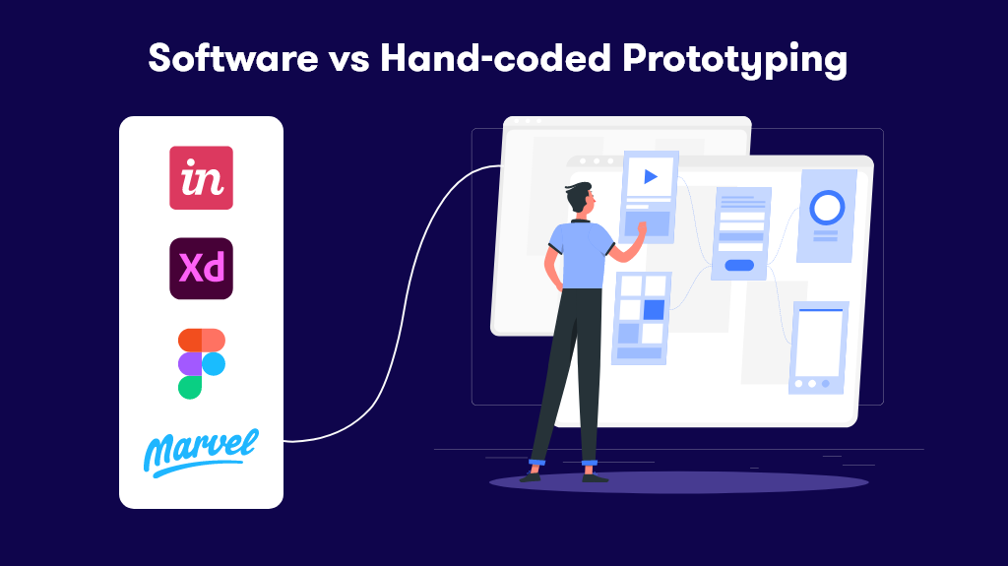


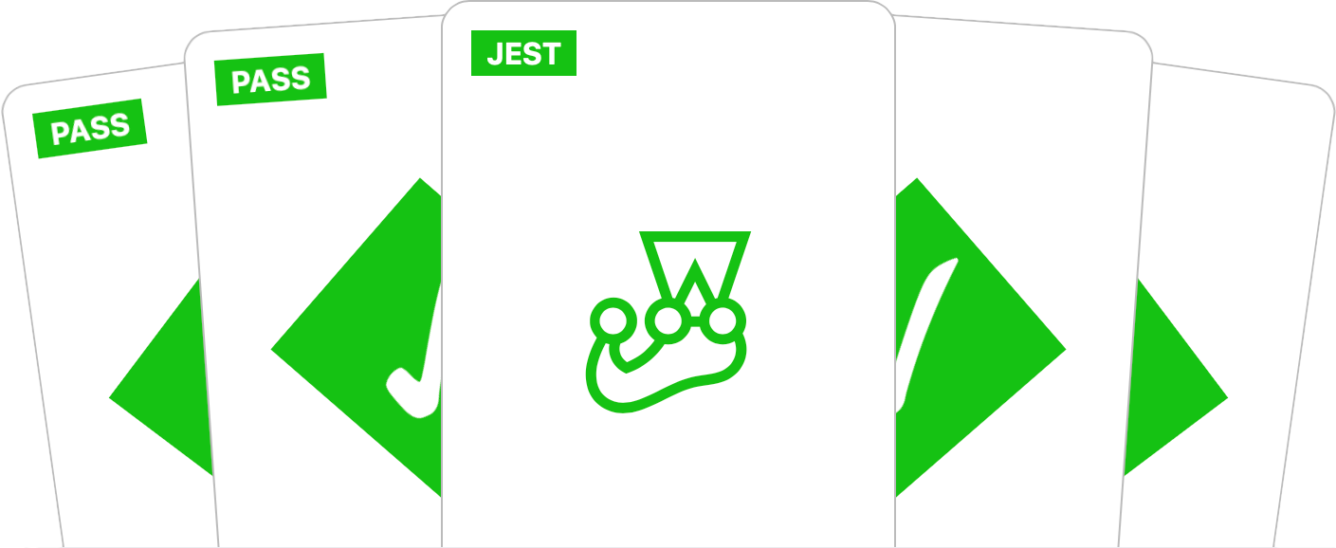
Tools
Prototyping
We’ll be using various technologies and frameworks to track, document, and manage our project.
Implement 10+10 strategy: each group member will create 10 low-fidelity prototypes, and then we'll choose the best 10 to create our prototype.

Slide 8
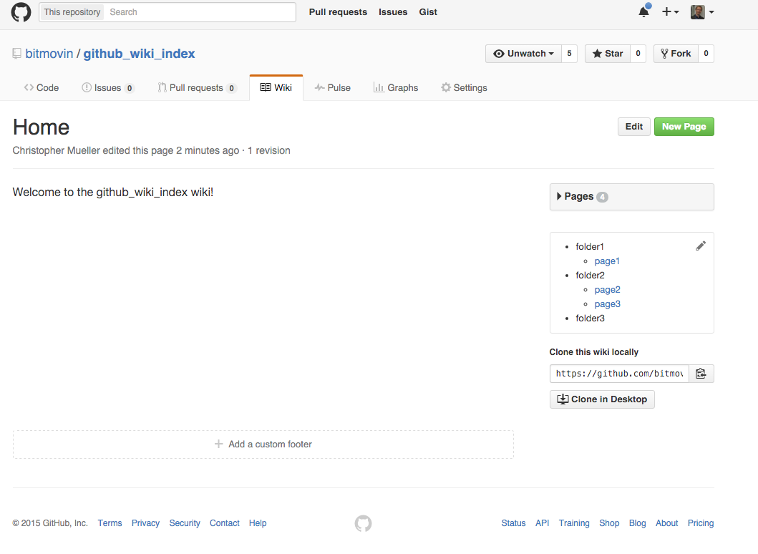
Wiki Pages
How to use our project
How we designed it
Deliverable explanations
https://docs.github.com/en/communities/documenting-your-project-with-wikis/about-wikis

Slide 9
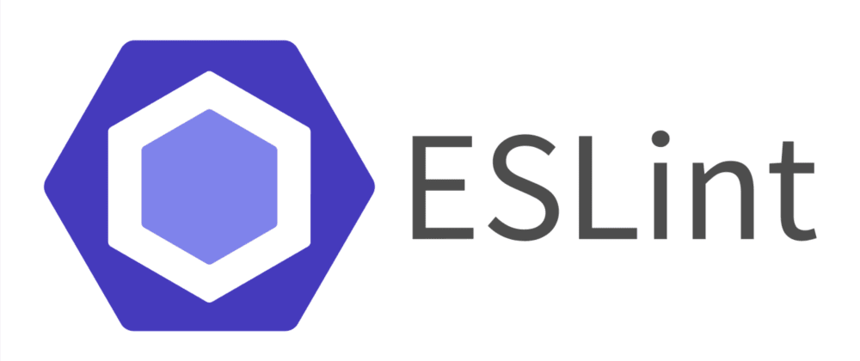
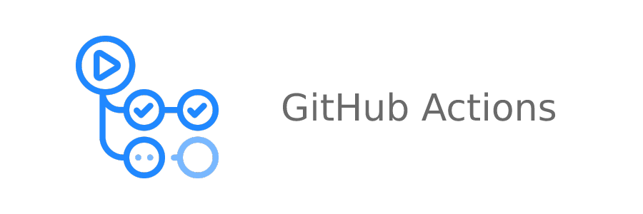

Build Management
Our linter of choice
Continuous integration technology to ensure the build has all tests passing and does actually build.
Notes:
For our continuous integration we will be using GitHub Actions. It will be able to test to ensure that the project does in fact build as well as run all the automated tests to make sure they all pass.
For our issue tracking we will be using GitHub Issues, we will be using it to track any bugs that are caught during development
For project management we will be using a scrum board through GitHub Projects. We will use this to track the user stories and what stage of development they are currently at.
ESLint will help us to ensure we are following our code style by linting our code.
Our coverage testing will be implemented in a variety of ways:
The first is using a checklist or guideline of what tests should be done, ensuring all tests that are needed do get written for each feature
The second is by utilizing both automated tests and manual testing
Focussing on quality of tests vs quantity so we can focus on the more important areas instead of making lots of useless tests

Slide 10
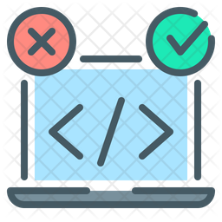
Testing Technologies
Unit Tests
Jest
UI Tests
Jest + React Testing Library
Integration Tests
Jest
https://jestjs.io/

Slide 11
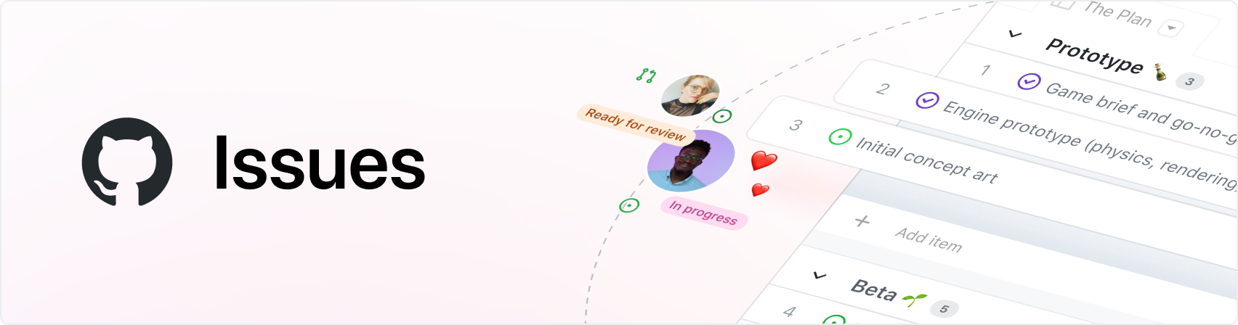

Issue Tracking
Bug
Reports
Error Detection
Metrics & Analytics
Logs

Slide 12
Risk Management
Understanding new technologies
Someone dropping the course or getting sick/busy
Someone not participating or not putting in the effort needed to complete their tasks
Working in a team (Merge conflicts)
Communication & time management
Underestimating the amount of work
Health data risks
Potentials
Notes:
A software development project is like a professional romantic relationship, there are many problems that can arise depending on the scope, commitment issues, and how many people are working on it. Some of the technologies we are using are new to a lot of our team members, so there a big part of our initial development process will be getting used to the technologies. Also, not knowing a technology can lead to mistakes like not using best practices, or not knowing the risks or common bugs of that technology. There are different skills associated with working in a team rather than by yourself. With 10 people on our team there are many potential risks such as, someone dropping the course, getting sick or busy, not participating or not putting in the effort to complete their tasks. You need strong communication to avoid git issues like merge conflicts. Considering the scope of our project we have to make sure we do not underestimate the amount of work to be done for each component. Also, since we are working on people’s health data our software needs to be extremely secure and private to avoid any data leaks.
Scope
requirements
Underestimating
Team size
communication
Risk manager doing stuff
Dropping, sick, not doing work, learning to work in a group
Learning
Not knowing tech, best practices, common bugs
Security
No data leaks
Dependence on 3rd party software
Requirement or technology changes

Slide 13

Thanks for watching.
Team 2

